Slide 1
COSGC Design Challenge Reviews
For 1 semester projects for COSGC Design Challenges, we usually hold 2-3 reviews:
A Preliminary Design Review (PDR)
A Critical Design Review (CDR)
For DemoSat and Wearables, there is a third review:
DemoSat: Flight Readiness Review (FRR)
Wearables: Final Project Review (FPR)
For 2 semester projects for COSGC Design Challenges, we hold 3-4 reviews:
A Conceptual Design Review (CoDR)
A Preliminary Design Review (PDR)
A Critical Design Review (CDR)
For DemoSat and Wearables, there is a fourth review:
DemoSat: Flight Readiness Review (FRR)
Wearables: Final Project Review (FPR)
Delete this slide before presenting

Slide 2
TEMPLATE NOTES
Each type of review requires somewhat different information, so each has its own template.
You can reformat the template to fit your design, but be sure to cover at least the information requested in each review template.
This template includes a lot of things. If you have difficulty with concepts, or don’t think you have time to include something, just let us know!
A good approach to creating effective slides is to use pictures and/or graphs – but fewer words. Don’t just read slides. Practice as a team, talking through each slide. Reviewers should hear the voices of every team member.
Delete this slide before presenting

Slide 3
TEMPLATE NOTES The Conceptual Design Review (CoDR) should:
Explain the concept of your Project
Define preliminary Goals
Present Concept of Operations
Delete this slide before presenting
Notes:
Need to include links to info on r4equirements and ConOps

Slide 4
References
This template asks for a few things that might be new to you (e.g. Project Goals, ConOps, etc.) Here are a few places to start learning about them.
Project Goals
ConOps
Examples of ConOps
Software Flow Chart
Functional Block Diagram (FBD)
Delete this slide before presenting

Slide 5
TEMPLATE NOTES The purpose of the CoDR is to verify that:
The project goals are well-defined and understood.
Verify that the Concept of Operations provides for meeting all project goals.
The proposed design meets time and monetary budget available.
Delete this slide before presenting
Notes:
Need to include links to info on r4equirements and ConOps

Slide 6
Later Reviews
Preliminary Design Review (PDR): Have obtained and tested subsystems (e.g. individual sensors, motors…)
Critical Design Review (CDR): Subsystems are integrated and working together
For DemoSat: Launch Readiness Review : Is your payload fully integrated and tested? Have all safety and other flight requirements been met?
For Wearables: Final Project Review (FPR)
Delete this slide before presenting

Slide 7

Team Name Conceptual Design Review
*Replace this text with a picture relevant to your project*
Institution
Team Members
COSGC Robotics Challenge
Date
Notes:
Titlw slide

Slide 8
Project Overview
Name of Presenter(s)
Notes:
Introduces your team to the reviewers, and gives summary of what you are planning to do, and why.

Slide 9
Team Member Introductions (team member name here.)
For each team member, include slide with:
Name (include preferred name and pronouns if you want.)
Major (and transfer plans if applicable.)
Role on team.
Something you like to do that has nothing to do with project.
Notes:
Please include one slide for each team member. Include a photo of each team member.

Slide 10
Robotics Problem Overview (1 slide)
What capabilities must your robot have?
What are tasks robot must complete?
What problems (either internal or external to your robot) might keep your robot from being successful?
What resource limitations (money, time, expertise, etc) may keep your team from building a successful robot?
Anticipating these obstacles is the first step in designing a plan to avoid or mitigate their effects.

Slide 11
Project Goals (1 Slide)
Project goals help to:
Determine if the project is achievable within constraints of the project
Ensure that all team members understand what their role is in helping the project succeed
Set testing and completion requirements for tasks (how do you show that part X of the project is complete and correct?)
Delete this slide before presenting

Slide 12
Example: Project Overview and Objectives
Overview:
The Cryo-Aerosol Dust Collection team shall build an aerosol auto-sampler that adds context and quantifiable data to the Cryospheric dust collection process.
Objectives:
Deploy on the surface of icy and mountainous regions for extended amounts of time with minimal human interactions
Provide environmental data linking dust deposition patterns to wind events and atmospheric patterns
Collect dust samples that will be turned over to NSIDC for further analysis
.

Slide 13
Robotics Design Overview (4-6 slides)
What are the major components in your robot’s design?
Structure:
what are the different parts of your structure?
What method of propulsion will you use?
How do the motors attach?
Where are electronics and batteries housed?
Where are sensors mounted?
Include pictures! Hand drawn is fine, we want to see preliminary ideas.
Major technology dependencies: what kind of sensors, motors, batteries, etc will you need?
What do the capabilities of the sensors need to be? (ex. Think about some issues you may have when moving, what temperature you expect to operate in, etc.)

Slide 14
Robotics Design Overview Continued
Major Components (cont’d)
Electrical: what does your electrical system need to do?
Store data (memory), sampling sensors, provide power?
Will you use already developed items? How will you use them in a novel way? How will you integrate them?

Slide 15
Design Overview: Functional Block Diagrams (1-2 slides)
(If you don’t have this yet, that’s ok! Keep working at it and present it at PDR)
Functional block diagram
Shows how systems interact with each other
Mechanical – will show how wearable/robot is configured, such as sensor locations
Electrical – Shows how power will be provided to different components. As well as how data will be transmitted, stored
Examples on following slide(s)

Slide 16
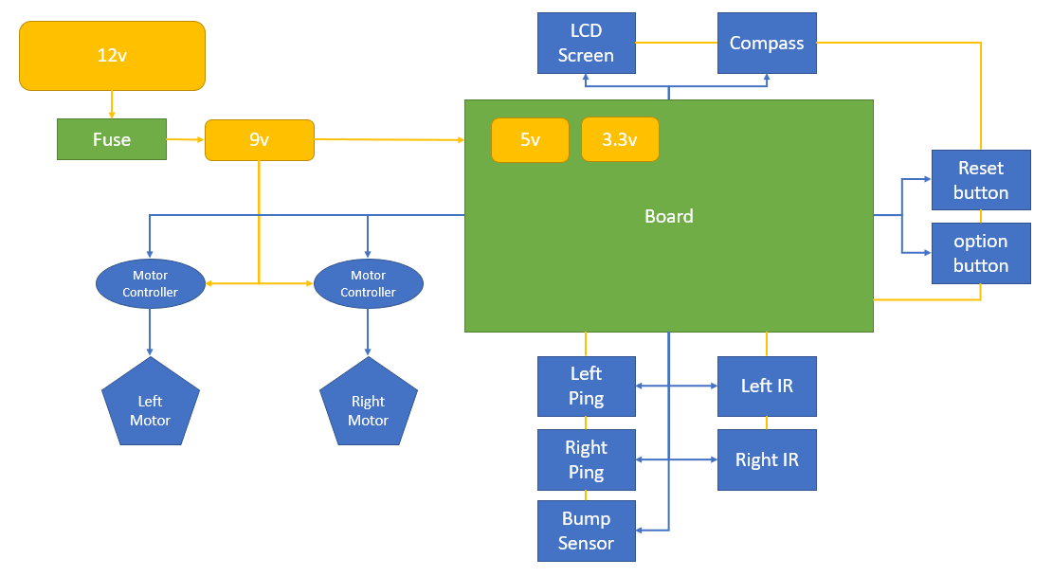
Example Robotics Functional Block Diagram (electrical and data)
We do not expect this slide to show your final electrical design, but would like to see some preliminary ideas. Design iterations are essential to success!
Notes:
FBD curtesy of Trinidad State College Robotics

Slide 17
Software(1-2 slides)
For this review, it is normal to have little (if any) software written. In the next review (PDR), you should have some sample code to show.
For this review (CoDR), please show a flow chart.
Start thinking about what language you will be coding in. What capabilities does your Wearable or Robot need?

Slide 18
Project Management
Name of Presenter(s)

Slide 19
Management (3-4 slides)
Preliminary schedule for the project
Include two primary points of contact: professor or advisor and project lead
We will be sending out important information in the future that MUST be communicated to all team members.

Slide 20
Management: Preliminary Timeline
You must also be able to show that you have enough time to complete your design.
Your first timeline will be a rough estimate. The project manager should update as project proceeds.
Don’t forget to include down time (for example, teams usually can’t order parts from mid-December to mid-January, and usually don’t get much work done in that time.)
Be realistic in your time estimates. Use the rule of Pi (things take pi times as long as you will think…)

Slide 21
Preliminary Timeline, continued
Factor in time necessary to get parts ordered and have them shipped.
Include time for design and fabrication. For example, teams that to 3-D print their structure typically take around 3 months to complete design and printing.

Slide 22
Preliminary Budget
To evaluate whether your design seems feasible or not, you must be able to show that you have enough money to complete your design.
Check with your project mentor to find out how much money they have allocated for your project, and what that includes (e.g. will they supply 3-D printing supplies, or must you purchase filament, etc?)
Your first budget will be an estimate, give a ballpark cost. For example, what does an Arduino cost? The sensor(s) you are proposing to use? Structural materials? Batteries?
Your budget should include enough money (a margin) for replacement parts, etc.

Slide 23
Risks and Worries
What are your biggest worries or potential failure points with your conceptual design?
Items identified should be completely mitigated through your design efforts and fully addressed by the Critical Design Review (CDR; the third review)

Slide 24
Conclusion (1-2 slides)
For conclusion, summarize the following:
Restate project goals
Issues, concerns
What questions do you have for us?
Plan for where you will take your design from here:
What do you need to investigate further (next steps)?
Are you ready to purchase subsystem hardware so you can start testing it? You will be asked about status of subsystems in the next review (PDR.)
Where do you hope to be by the next review? Be as specific as possible.

